Slide 1
Predicting Business Location Site
Applied Data Science Capstone

Slide 2
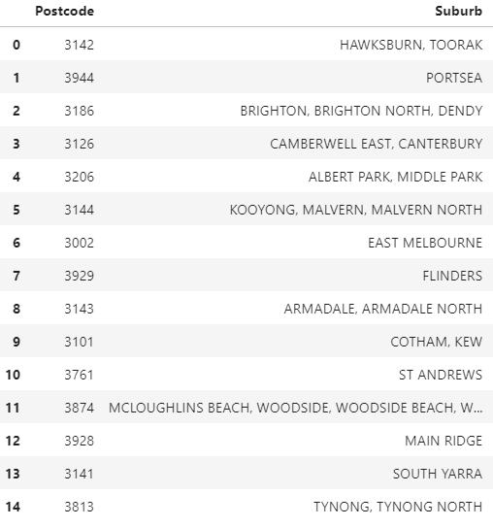
High-Income Suburbs Data Obtained from Australian Bureau of Statistics

Slide 3
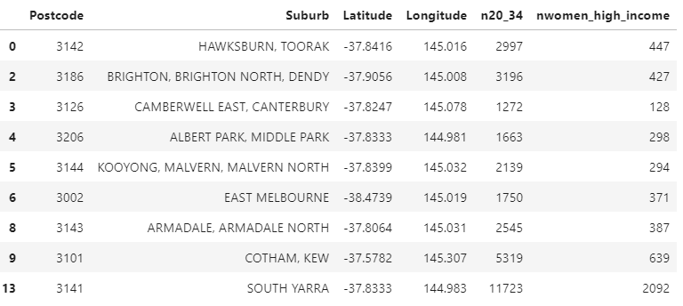
Locate ideal clientele Young, professional women >20<34 who earn >$1, 250 p/w

Slide 4
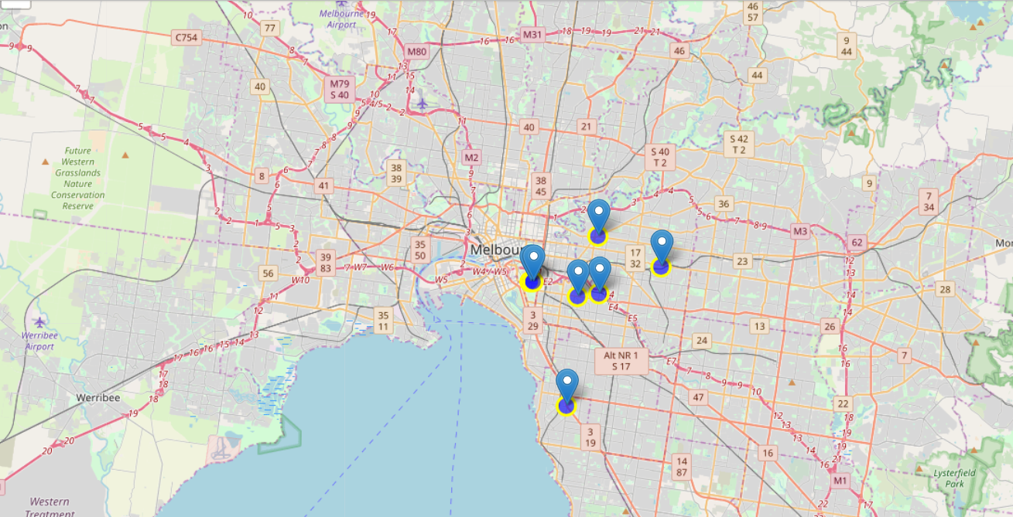
Create a map with potential site locations

Slide 5
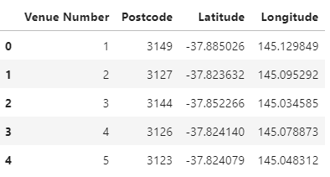
Identify anti-aging clinics with a 5-star customer rating

Slide 6
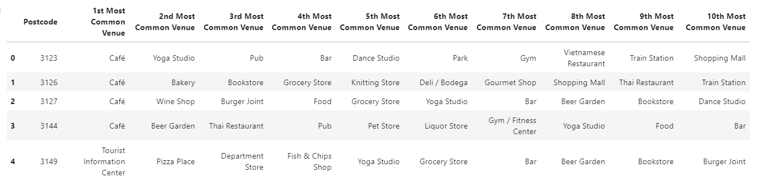
Group by Postcode – Most Common Venues Within an 800 Metre Radius

Slide 7
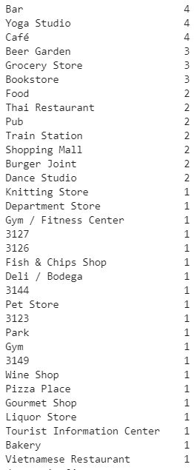
Sum of each Popular Venue Within an 800 Metre Radius

Slide 8
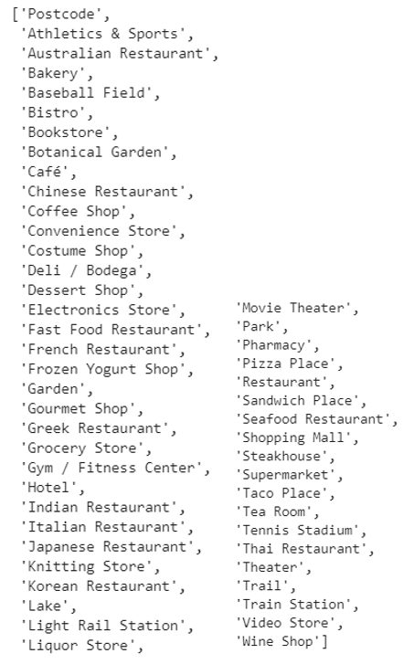
Make a list of all venues within 800 metres of possible site locations

Slide 9
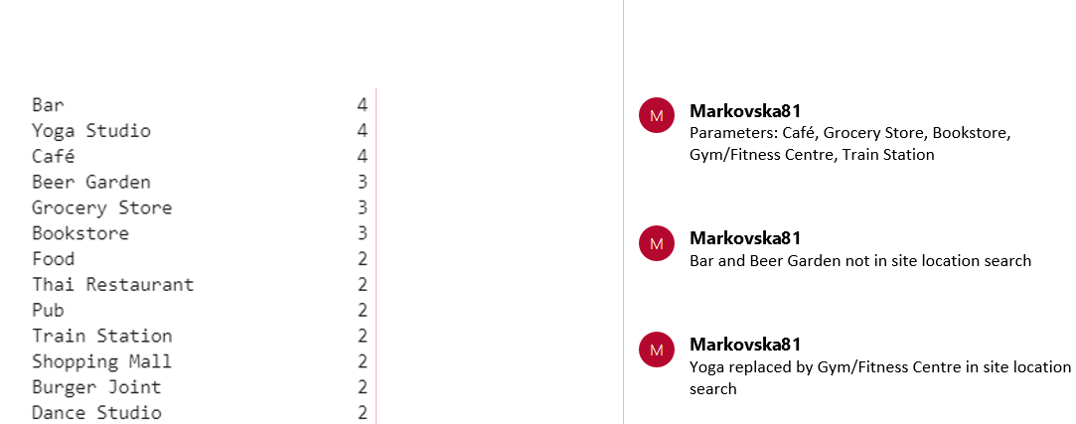
Select Parameters – Top 4 venues + Train Staion

Slide 10
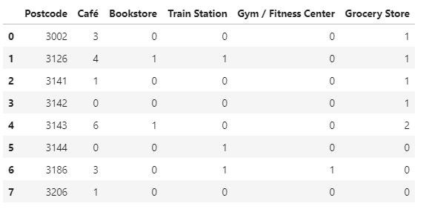
3126, 3144 and 3186 Qualify for Potential Site Location (Train Station)

Slide 11
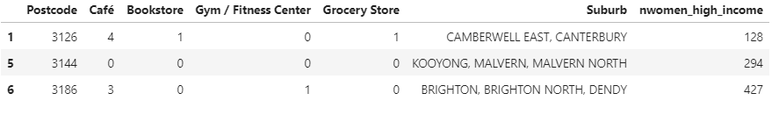
Results of Potential Site Locations

Slide 12
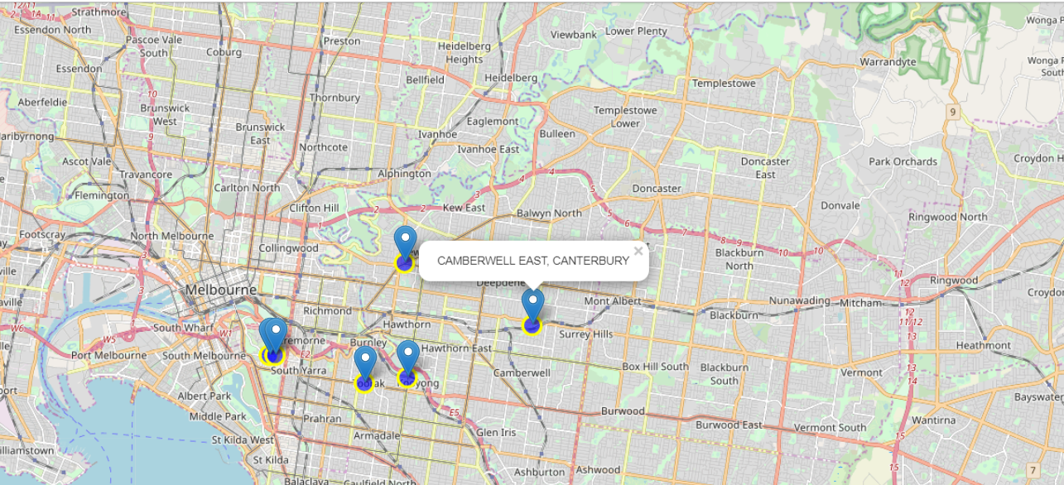
Best Location = Most Associated Venues = 3126 = Camberwell East and Canterbury

